Slide 1
Show Me Your Evidence - an Automatic Method for Context Dependent Evidence Detection
Rinott, Ruty, et al.
EMNLP 2015
Doyeon Lim
2018.10.09

Slide 2
Contents
Task Introduction
Related Work
Data
System Architecture
Technical Approach
Experimental Result
Further Work

Slide 3
Task Introduction
Research Problem
Design the pipeline for novel task; Context-Dependent Evidence Detection(CDED)
Definition of terms
Topic: a short phrase that frames the discussion
Claim: a general, concise statement that directly supports or contests the topic.
Context Dependent Evidence (CDE): a text segment that directly supports a claim in the context of the topic
Context-Dependent Evidence Detection(CDED): With a concrete topic, a relevant claim, and potentially relevant documents, automatically pinpoint CDE within these documents

Slide 4
Task Introduction
Criteria to be CDE
Evidence is classified one of three classes: - Study: Results of a quantitative analysis of data, given as numbers, or as conclusions. - Expert: Testimony by a person / group / committee/ organization with some known expertise / authority on the topic. - Anecdotal: A description of an episode(s), centered on individual(s) or clearly located in place and/or in time.
Evidence and Claim should be related & Evidence should be supportive to claim
Evidence should be coherent

Slide 5
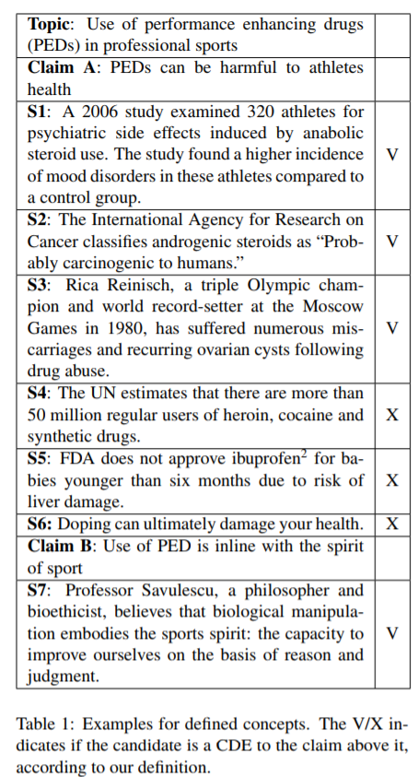
Unrelated
Not supportive

Slide 6
Task Introduction
Practical Application
support and persuasion enhancement in a wide range of domains

Slide 7
Related Work
Evidence Retrieval
Find whole evidence document for claim
Only works on factual assertion
Textual Entailment
Determine whether hypothesis H is entailed by text T
Only consider semantic inference
Question Answering
Offer unique and concise answer for the question

Slide 8
Data
Data: CDE is golden labeld by human annotator, generated from Wikipedia
Size: 39 Topics / 3,057 distinct CDE
Process:
Detection Stage: 5 Annotators read article and annotate CDEs
Confirmation stage: Different annotator confirm or reject for other annotators work & assign evidence type

Slide 9
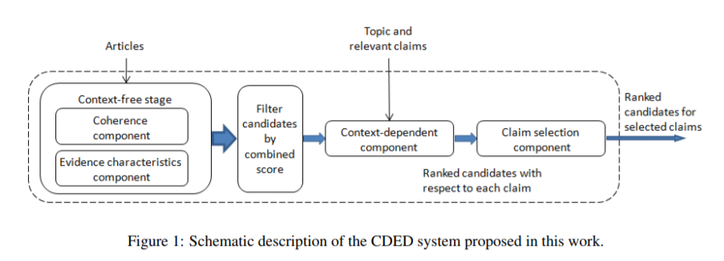
System Architecture
Input:
a topic
a set of related articles
a set of relevant claims detected within these articles
Output
Ranked list of candidate CDEs, originating from the text in the claim’s article, for an automatically selected subset of the input claims

Slide 10
System Architecture
Overall Steps
In same paragraph in article, 1-3 consecutive sentences becomes CDE candidate
Check coherency
Check evidence type
Filter the candidates with combined score
Use classifier to select good claims for the topic
All classifiers are Logistic Regression and confidence scores are used as score

Slide 11
Technical Approach
Coherence Component
Labeled data:
Positive instance: exact labeled CDE
Negative instance: else
Features:
incomplete quotes
related conjunctive adverb: however, nevertheless
Segment length
Unsolved co-references

Slide 12
Technical Approach
Evidence characteristics component
Labeled data:
Positive instance: all labeled CDE of the corresponding evidence type
Negative instance: all candidates that do not overlap labeled CDE of the relevant type, including CDE of other types
Features:
Lexicon: economist, philosopher, court... for expert
Named Entity Recognition (NER): fine grained categorie; educational organization, leader
Pattern: does that candidate contain a quote for expert
Subjectivity classifier: classifying objective or subjective

Slide 13
Technical Approach
Context-dependent component
Labeled data:
[topic / claim / CDE] triplets
Positive instance: Triplets in which the CDE and claim were linked
Negative instance: claims and CDEs detected in the same topic and article, but that were not linked
Features:
Semantic relatedness between the candidate and the claim
Semantic relatedness between text related to the candidate and the claim
Relative location of the candidate with respect to the claim
sentiment–agreement between the candidate and the claims
TF-IDF vector → acronym expansions using WordNet
Word2Vec

Slide 14
Technical Approach
Claim selection component
Rank all claims → probability that the claim’s article includes CDE of the relevant type, associated with the claim
Labeled data:
Positive instance: claims for which at least one CDE of the relevant type existed in the labeled data
Negative instance: included all remaining claims

Slide 15
Technical Approach
Claim selection component
Features:
Claim properties: 1. lexicon significantly associated with positive examples (lead, result, development and significant) 2. lexicons determining factual claims vs. non–factual claims
Claim’s relevance to topic and article Semantic relatedness between (1) the claim and the content of the claim’s article (2) the claim and topic
Properties of claim’s article

Slide 16
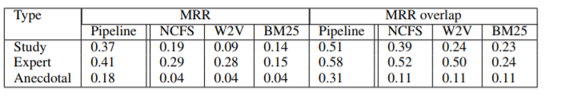
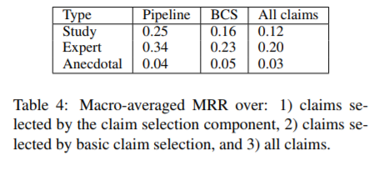
Experimental Result
Ranked 2~3

Slide 17
Further Work
It only suggest evidence which support claim
Only use Wikipedia data ➔ there are lots of web sources to use
Claim and evidence sets are manually tagged ➔ argument mining can detect it automatically

Slide 18
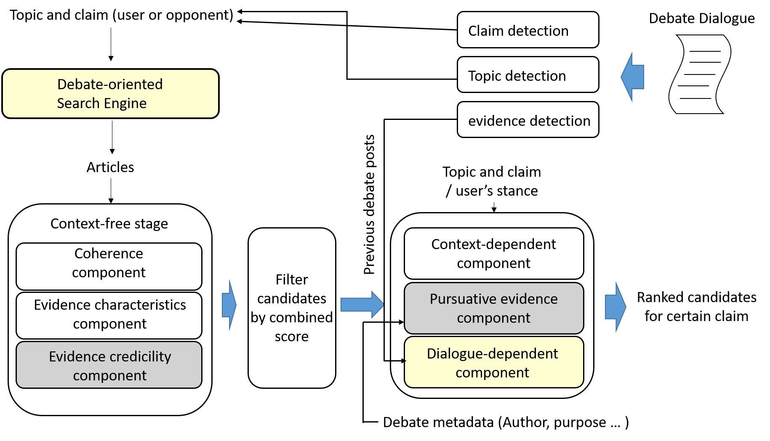
SuggestBot

